Slide 1

Real-Time Hand Detection and Finger Counting Using OpenCV and MediaPipe
A PROJECT FOR HUMAN-COMPUTER INTERACTION AND GESTURE-BASED CONTROL
BY: YOUSSEF WANIS
MAHMOUD
ABDALLAH

Slide 2



Real-Time Hand Detection and Finger Counting Using OpenCV and MediaPipe
Introduction
This project aims to create a real-time system for hand detection and finger counting, using computer vision techniques to enable gesture-based control in human-computer interaction (HCI). The ability to detect fingers in real-time has numerous applications in sign language interpretation, virtual reality (VR), and touchless interfaces.

Slide 3

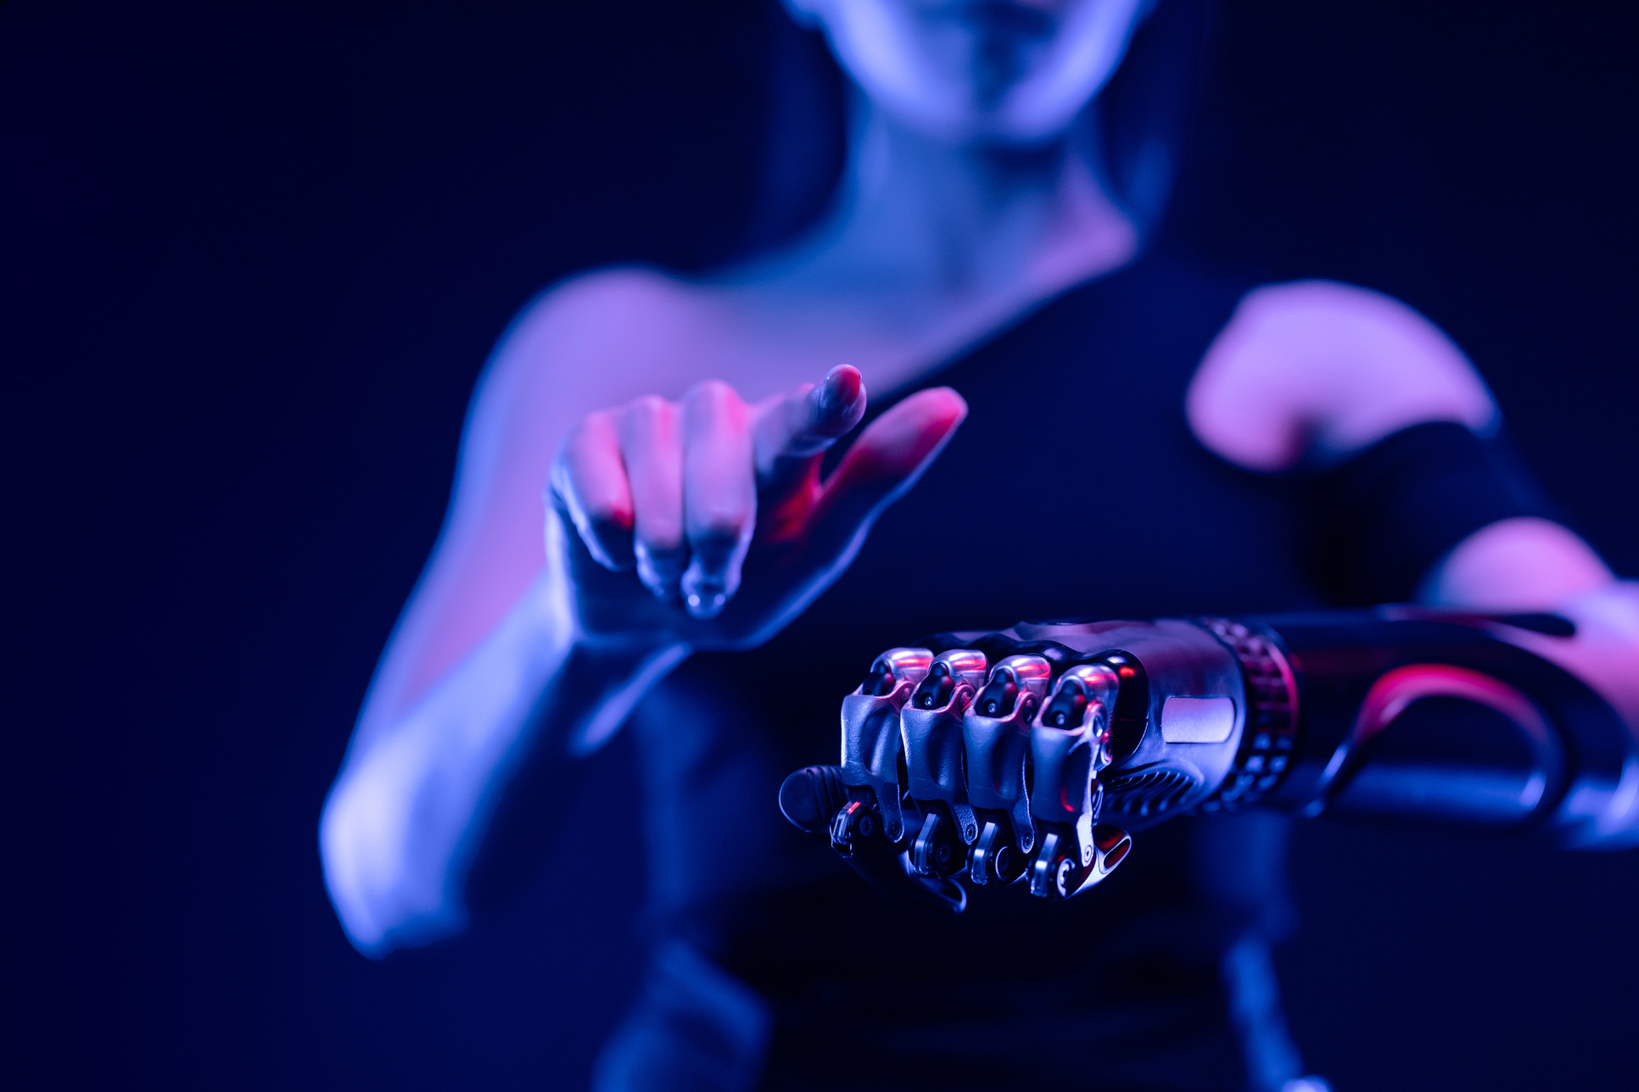

Real-Time Hand Detection and Finger Counting Using OpenCV and MediaPipe
Objective and Motivation
The main objective of this project is to implement a system that can track hands and count fingers in real-time. The motivation behind this project stems from the growing need for touchless interaction in modern applications, such as gesture control in VR/AR environments, improving accessibility, and building intuitive user interfaces.

Slide 4
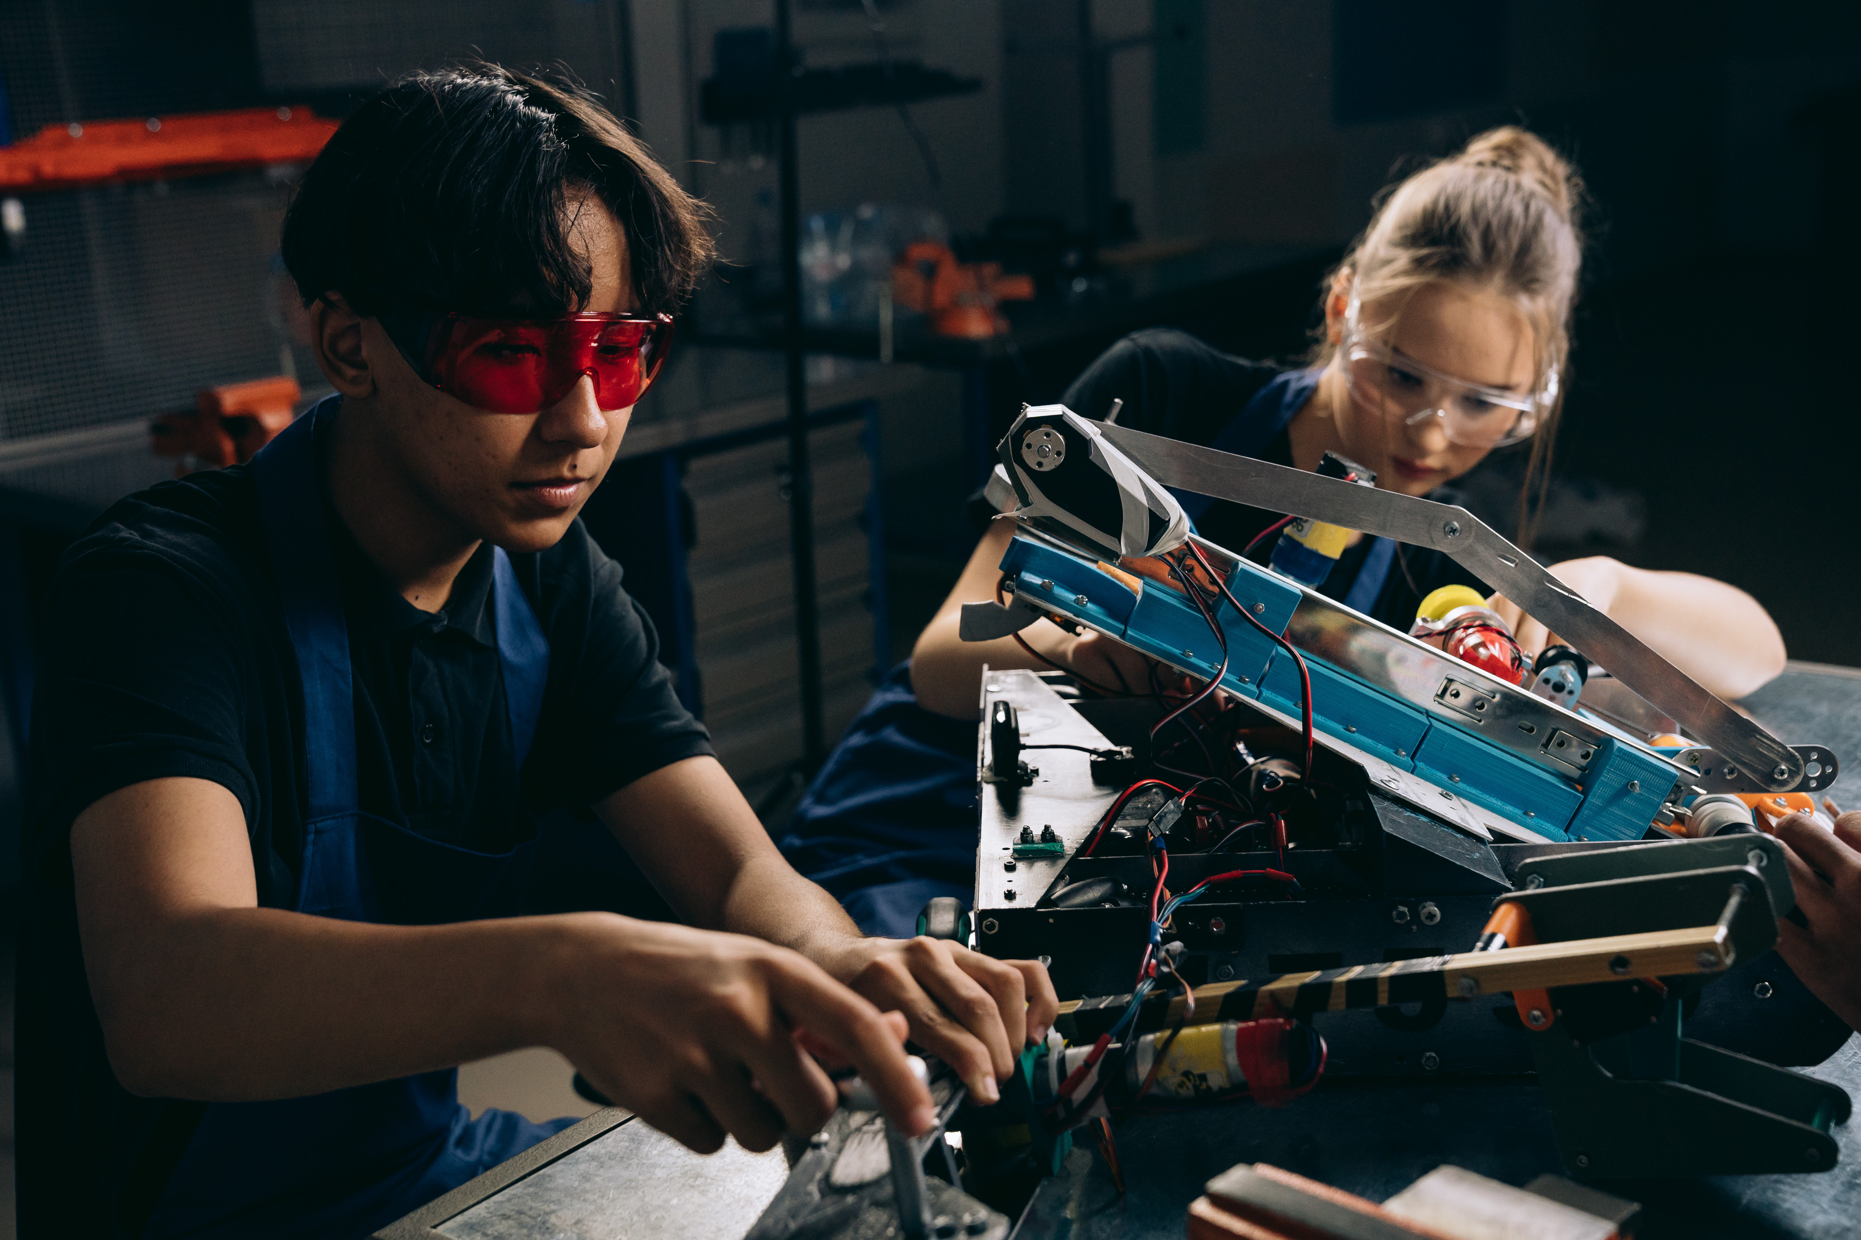

Real-Time Hand Detection and Finger Counting Using OpenCV and MediaPipe
OpenCV:
MediaPipe
A framework designed for machine learning pipelines, used here for detecting and tracking hands and finger landmarks.
Technology Used
A powerful library for real-time computer vision tasks.

Slide 5
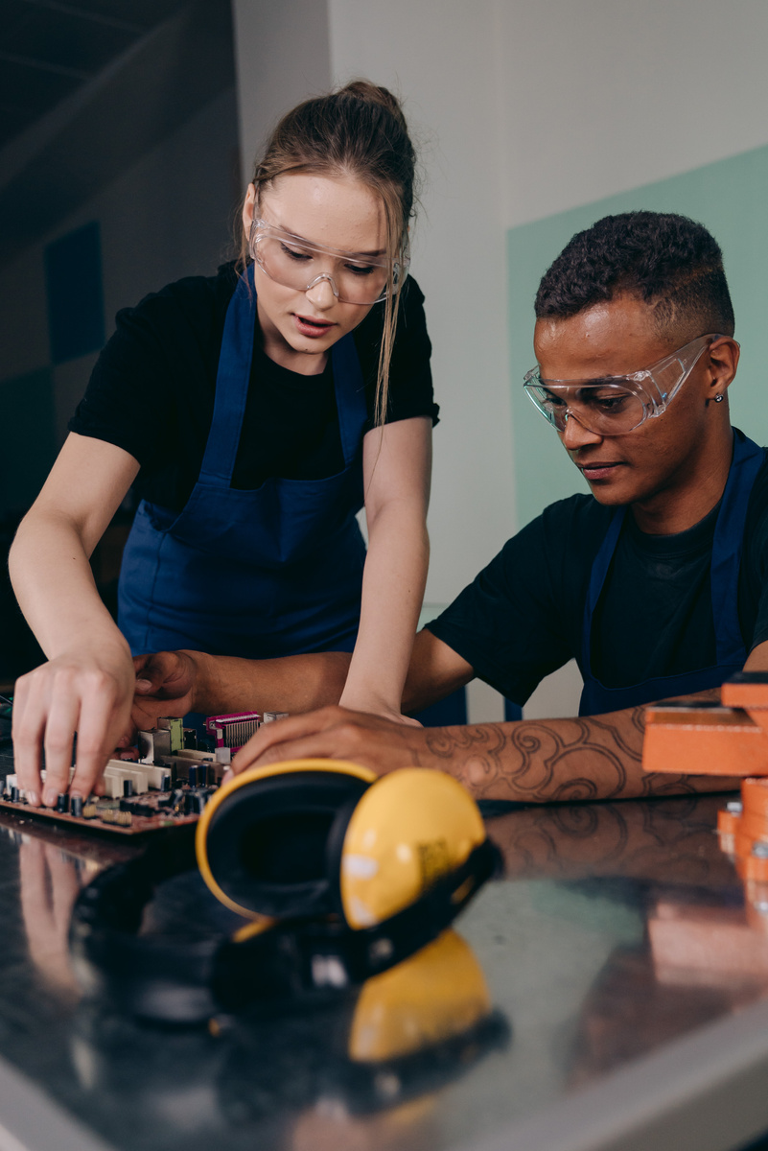
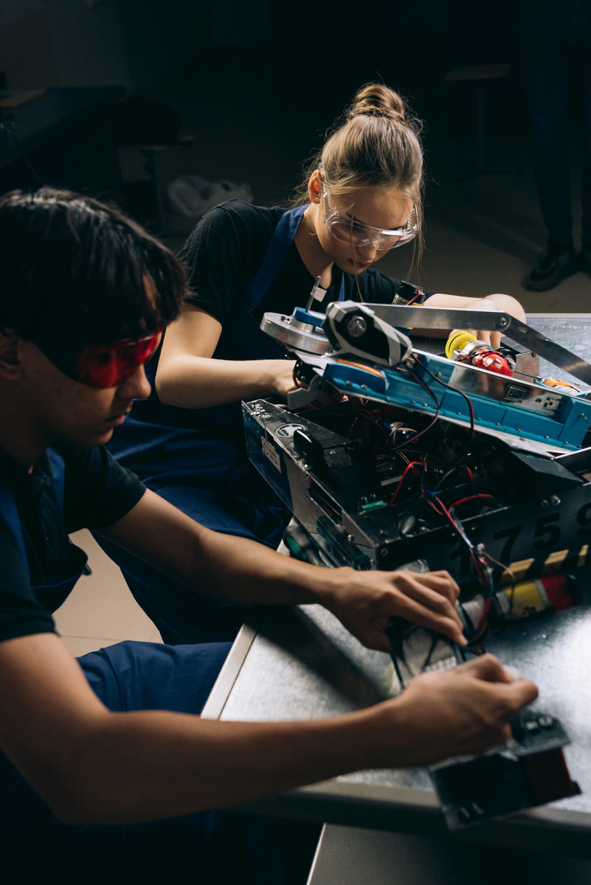
Real-Time Hand Detection and Finger Counting Using OpenCV and MediaPipe
Hand Detector Class Overview
The handDetector class handles the core logic of detecting hands and finger positions:
findHands: Detects hands in the frame using MediaPipe.
findPosition: Identifies the landmarks (joint positions) for each detected hand.
fingersUp: Determines how many fingers are raised based on landmarks, enabling finger counting.

Slide 6


Real-Time Hand Detection and Finger Counting Using OpenCV and MediaPipe
Real-Time Finger Counting
Finger counting is implemented by analyzing the position of each finger's tip and corresponding joints. For each finger:
If the tip is above the joint, the finger is considered raised.
For thumbs, specific horizontal positions are analyzed due to the different angle of movement.
This method provides real-time feedback on how many fingers are up, even for multiple hands.

Slide 7
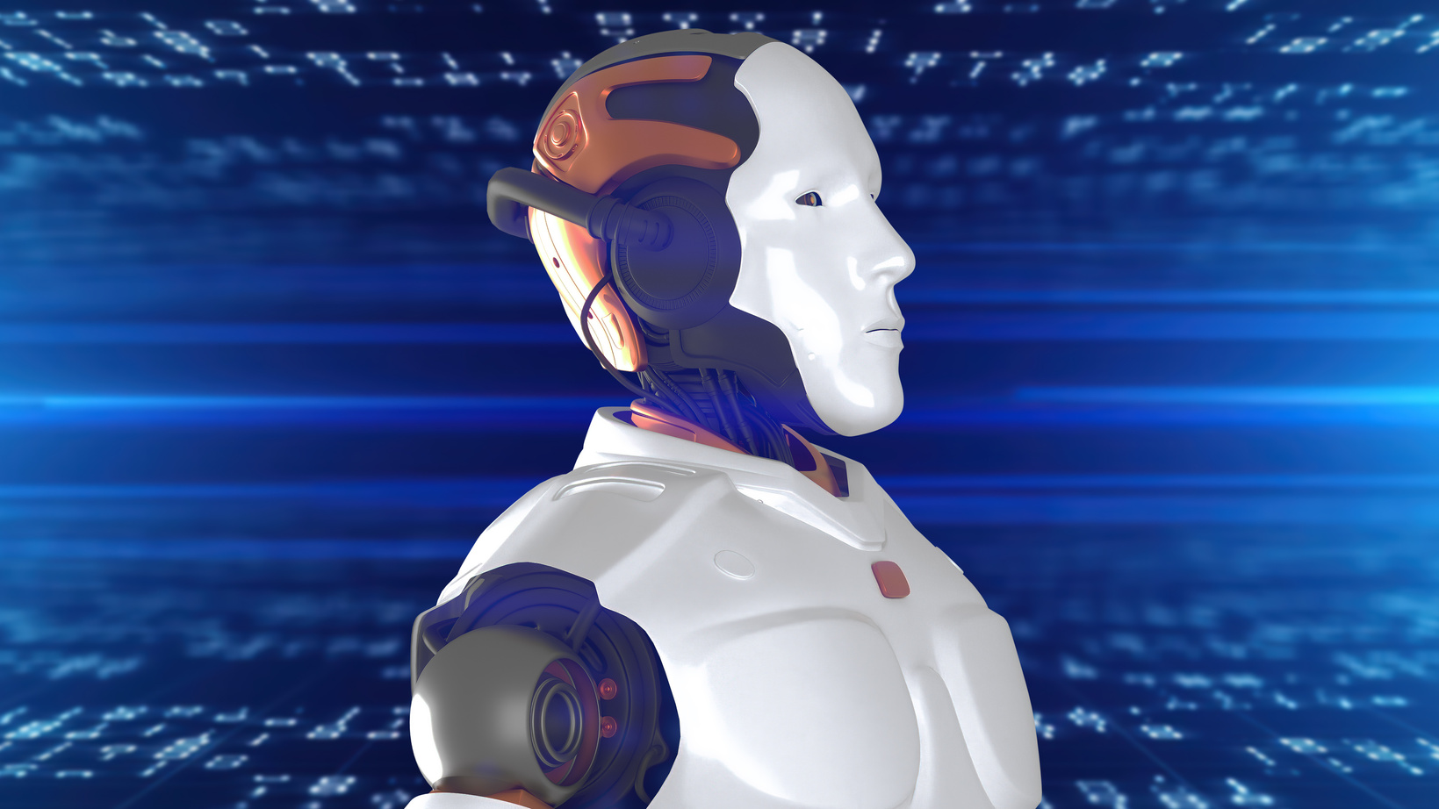
Real-Time Hand Detection and Finger Counting Using OpenCV and MediaPipe
Applications and Future Work
This project has applications in:
Sign Language Recognition: Detecting and interpreting specific hand gestures.
Gesture-Based Control: Allowing users to control devices or interfaces using hand gestures.
Virtual Reality: Enhancing VR environments by enabling natural hand interactions.
Future improvements include:
Detecting full hand gestures for more complex interactions.
Enhancing performance under varying lighting conditions.

Slide 8

Real-Time Hand Detection and Finger Counting Using OpenCV and MediaPipe
Conclusion
This project demonstrates the use of OpenCV and MediaPipe for real-time hand detection and finger counting. With applications in HCI, accessibility, and VR, this system showcases the potential for gesture-based control in modern technology. Questions and feedback are welcome!

Slide 9
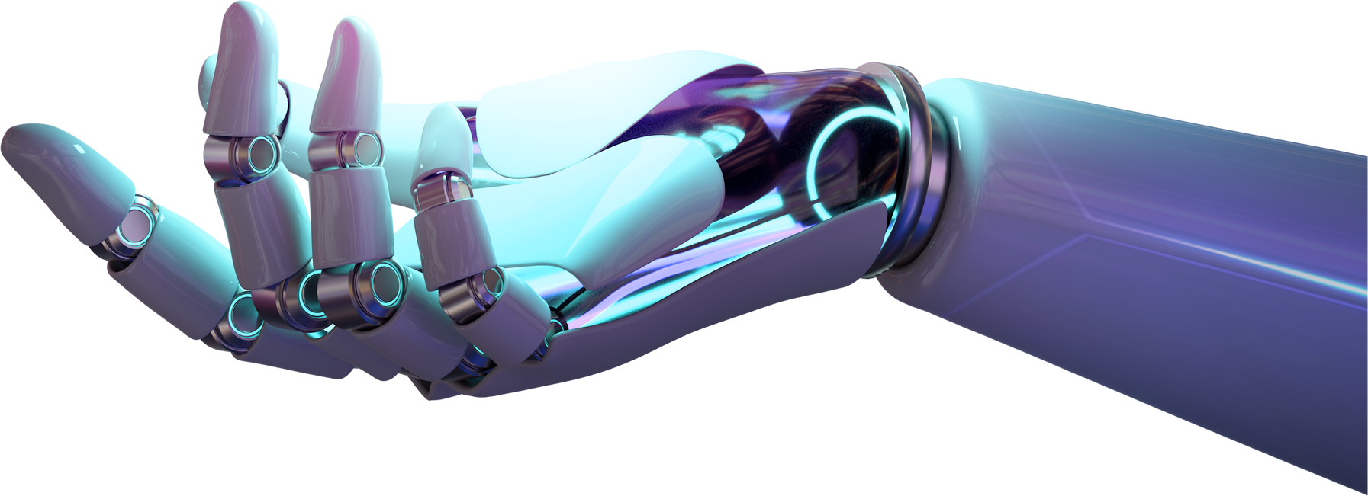
Real-Time Hand Detection and Finger Counting Using OpenCV and MediaPipe
Thank You
FOR YOUR ATTENTION

